Slide 1
IELTS WRITING TASK 2

Slide 2
HOW TO PLAN A GOOD PARAGRAPH
Analyze the question
Brainstorm ideas
Organize your ideas
Write the essay
Check the grammar

Slide 3
AGREE OR DISAGREE
In the last 20 years there have been significant developments in the field of information technology (IT), for example the World Wide Web and communication by email. However, these developments in IT are likely to have more negative effects than positive in the future.
To what extent do you agree with this view?

Slide 4
DISCUSS TWO OPPOSING OPINIONS
Some people believe the aim of university education is to help graduates get better jobs. Others believe there are much wider benefits of university education for both individuals and society.
Discuss both views and give your opinion.

Slide 5
ADVANTAGES & DISAVANTAGES
a In order to solve traffic problems, governments should tax private car owners heavily and use the money to improve public transportation.
What are the advantages and disadvantages of such a solution?
b People now have the freedom to work and live anywhere in the world due to the development of communication technology and transportation.
Do the advantages of this development outweigh the disadvantages?

Slide 6
PROBLEMS AND SOLUTIONS
a Nowadays many people have access to computers on a wide basis and a large number of children play computer games.
What are the negative impacts of playing computer games and what can be done to minimize the bad effects?
b The internet has transformed the way information is shared and consumed, but it has also created problems that did not exist before.
What are the most serious problems associated with the internet and what solutions can you suggest?

Slide 7
CAUSES (REASONS) - SOLUTION
Levels of youth crime are increasing rapidly in most cities around the world.
What are the reasons for this, and suggest some solutions.
Global warming is one of the most serious issues that the world is facing today.
What are the causes of global warming and what measures can governments and individuals take to tackle the issue?

Slide 8
CAUSES AND EFFECTS
The percentage of overweight children in western society has increased by almost 20% in the last ten years.
Discuss the causes and effects of this disturbing trend.

Slide 9
ELEMENTS OF A STRONG PARAGRAPH
Unity: A paragraph should focus around one main idea.
Development: This idea should be developed (explained) in the other sentences.
Coherence: The idea should be explained in a clear and logical way.

Slide 10
Essay 1 Introduction 2 Body 1 3 Body 2 4 Conclusion

Slide 11
ONE-IDEA PARAGRAPH
There have been major advances in technology over recent decades and this has led to significant improvements in people’s lives.
To what extend do you agree or disagree?

Slide 12
ANALYZE THE EXAMPLE
Our lives are much more convenient. In addition, the speed of modern devices means we have more time to do things in our free time. Our time is saved which is beneficial to us. Technological devices are also easily available because they can be found cheaply these days in most shops

Slide 13
SOLUTION
Give one idea
Give a reason WHY this idea is true
Give an example of it
Say what the implications / effects of this example are
Conclude the paragraph.

Slide 15
SOLUTION
Ý chính: Hút thuốc lá có hại cho phổi
Câu 1
Câu 2
Câu 3
Câu 4

Slide 16
Brainstorming / Planning notes
How has technology benefited people?
Idea: more convenience
Why? Can do things away from home – important due to busy lifestyles
Ex: Phone & laptops; Wi-fi everywhere
Result: can work, talk, email – coffee shops, while travelling
Conc: not possible without technology

Slide 17
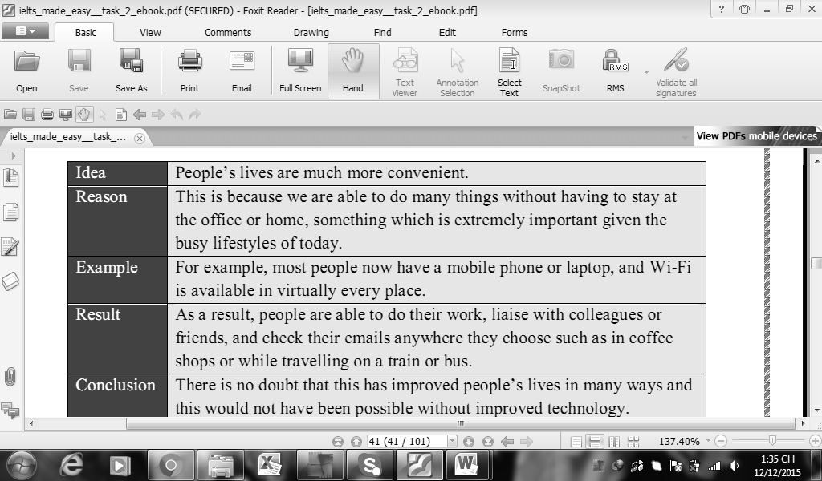

Slide 18
The main benefit of modern technology is that people’s lives are much more convenient. This is because we are able to do many things without having to stay at the offices or home, something which is extremely important given the busy lifestyles of today. For example, most people now have a mobile phone or a laptop computer, and Wi-Fi is available in virtually every place. As a result, people are able to do their work, liaise with colleagues or friends, and check their mails anywhere they choose such as in coffee shops or while travelling on a train or bus. There is no doubt that this has improved people’s lives in many ways and this would not have been possible without improved technology.

Slide 19
MULTIPLE IDEA PARAGRAPH
In this type of paragraph, multiple supporting ideas are presented to support the main idea in the topic sentence.
Transitions to introduce each new supporting idea: firstly, secondly, moreover, furthermore, also, in addition; more sophisticated: ‘The first reason that ..’

Slide 20
CÂU DẪN: HÚT THUỐC LÁ CÓ HẠI CHO SỨC KHỎE Firstly, HẠI CHO PHỔI Ý HỖ TRỢ: Lý do Secondly, HÚT THUỐC LÁ GÂY HẠI CHO MIỆNG Ý HỖ TRỢ: Hậu quả
Ý CHÍNH: HẠI CHO PHỔI
Ý HỖ TRỢ 1:
Ý HỖ TRỢ 2:
Ý HỖ TRỢ 3:
Ý HỖ TRỢ 4:

Slide 21
There is no doubt that modern technology has improved people’s lives in many ways. Firstly, people’s lives are much more convenient because we have devices such as mobile phones, meaning that people can communicate when and where they like, not just in the office or home. In addition, people are living much longer lives due to the advances in medical technology, with doctors are now able to carry out complicated heart surgery and other operations that were not possible many years ago. People’s lives have also improved around the home. Evidence of this can be seen with all the machines that are now available to people that save time such as washing machines and dish washers. None of this would have been possible without advances in technology.

Slide 22
Topic sentence (Câu mở đầu đoạn văn)
1.1 – Main idea 1
1.2 – Supporting sentences: support for 1
1.3 – Main idea 2
1.4 – Supporting sentences: support for 2

Slide 23
Ô nhiễm môi trường ảnh hưởng đến sức khỏe.
1.1 – Ảnh hưởng đến đường hô hấp
1.2 – Hít không khí dơ từ khói bụi.
1.3 – Gây ra ung thư
1.4 – Con người sống ở môi trường dơ → cơ thể tồn đọng chất độc → gây ra các bệnh về ung thư

Slide 24
Countries with a large proportion of young adults may experience various problems. Firstly, if considerable numbers of people leave school or university at the same time, there will be intense competition for jobs. This oversupply of labour could cause an increase in unemployment. Secondly, an abundance of working-age adults may result in higher rates of poverty and falling living standards, as governments or local councils are unable to meet the demand for the provision of housing and public services. Finally, there is a risk that rates of crime and antisocial behaviour may rise if the needs of a young population are not met.

Slide 25
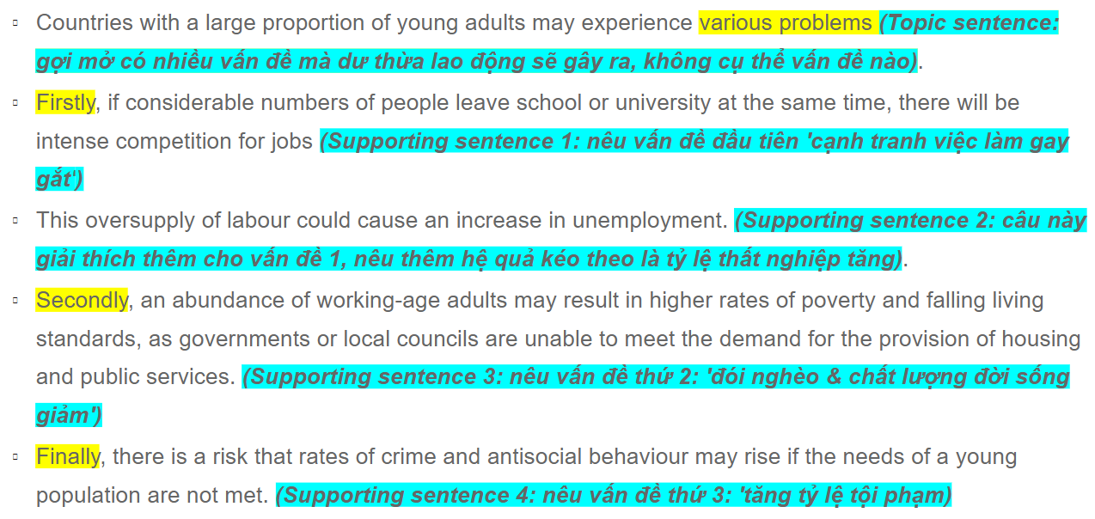

Slide 26
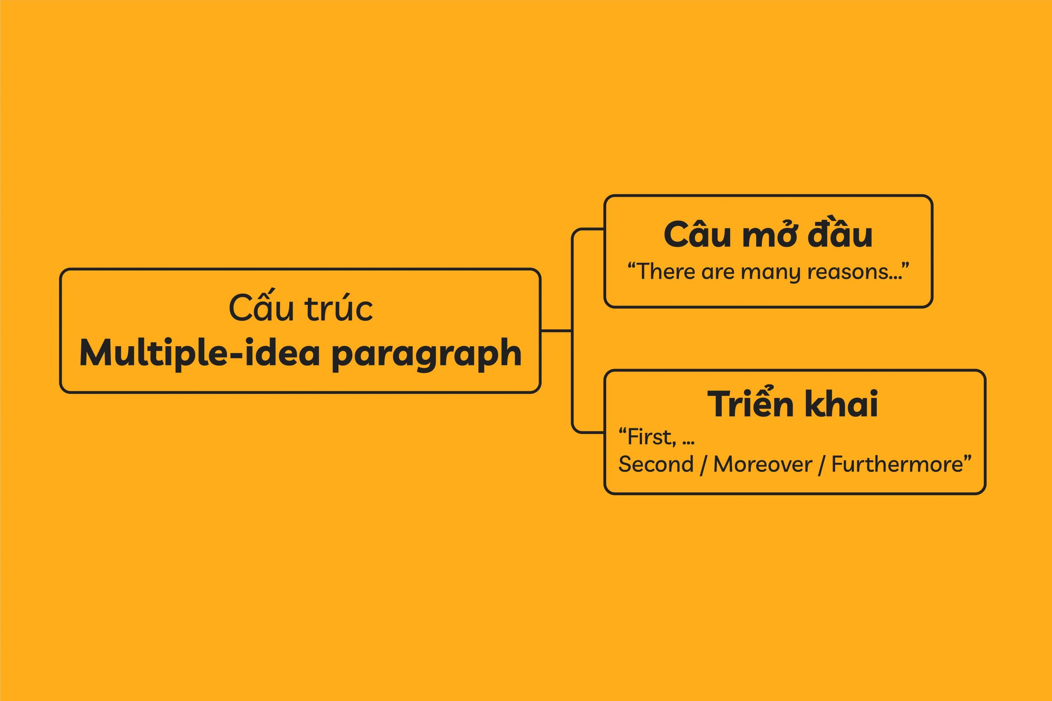

Slide 27
1. Topic sentence: Say the sentence + in many reasons/ in many ways/ with various problems/ some solutions. 1.1. First and foremost,/ The first reasons is that/ The primary reason is that/ Firstly, … 1.2. Reasons (Because/ as..) / Examples (For example/ For instance…/ Explanation (To specify,)/ Effects (As a result, Consequently,…) 1.3. Another reason is that/ Secondly,/ In addition,/ Moreover,… 1.4. Reasons (Because/ as..) / Examples (For example/ For instance…/ Explanation (To specify,)/ Effects (As a result, Consequently,…) 1.5. Finally, …. 1.6. Reasons (Because/ as..) / Examples (For example/ For instance…/ Explanation (To specify,)/ Effects (As a result, Consequently,…)

Slide 28
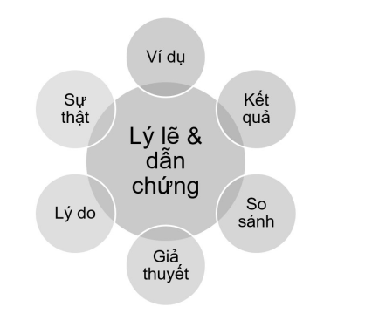

Slide 29
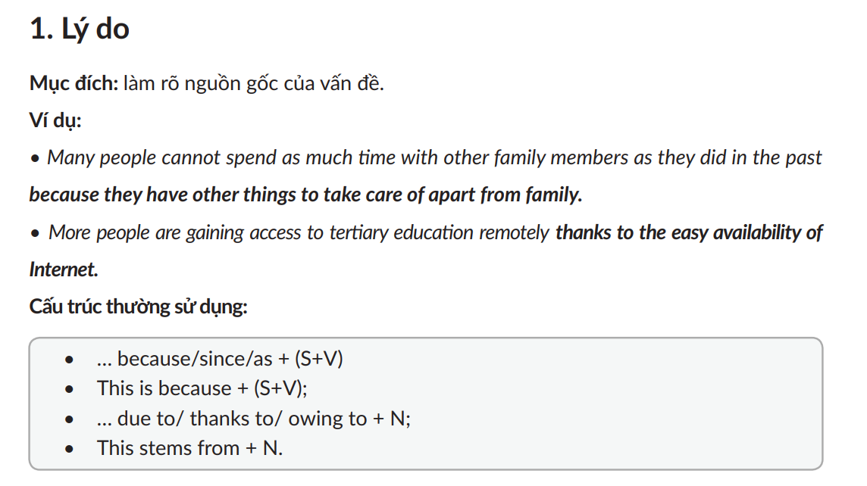



Slide 30
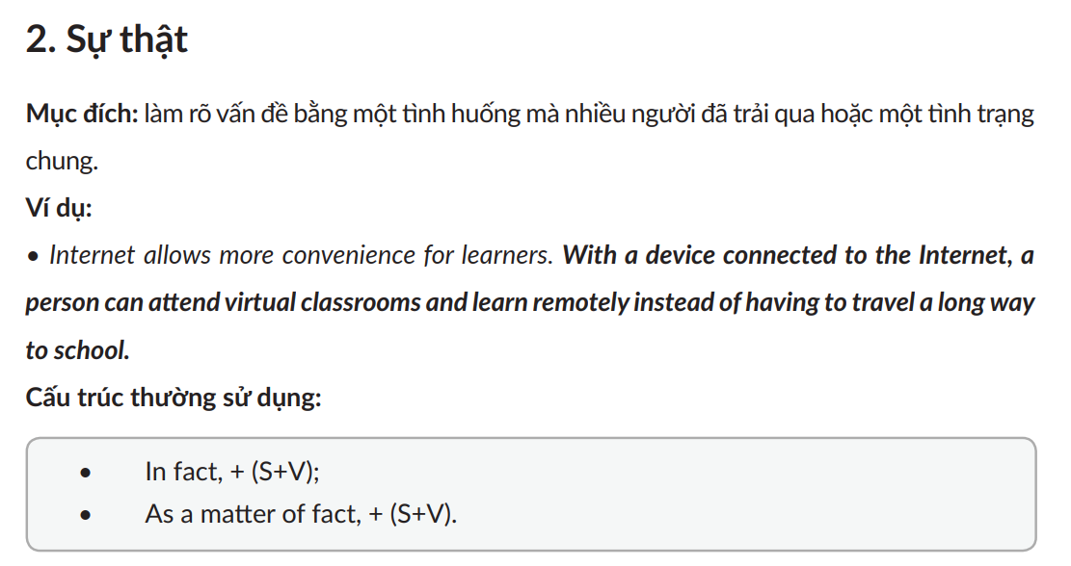

Slide 31
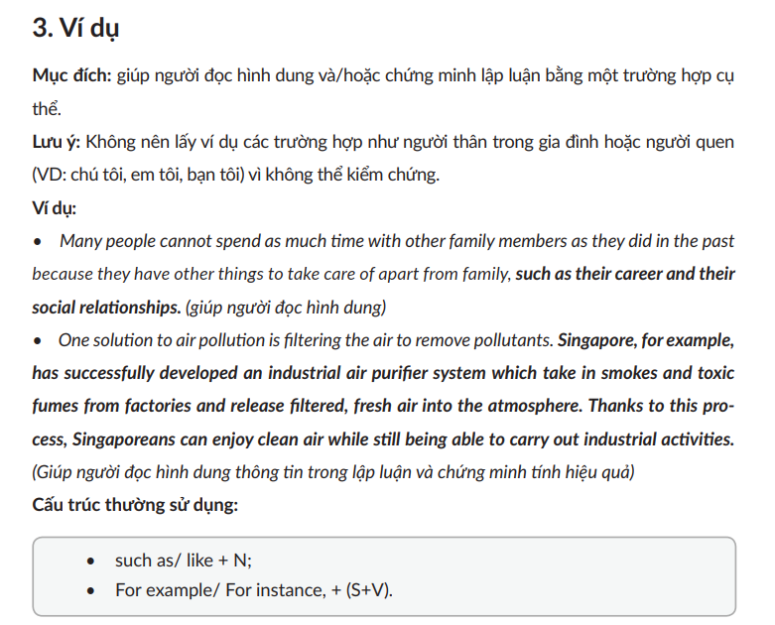

Slide 32
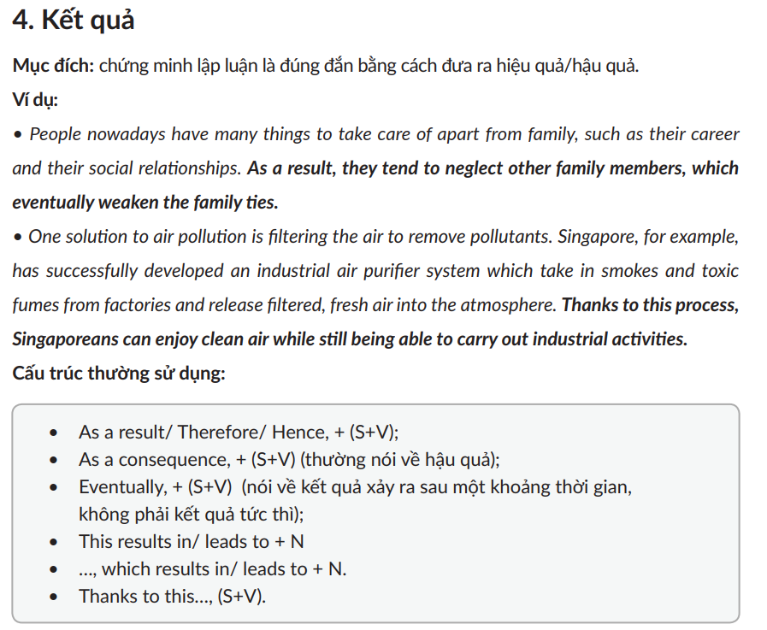





Slide 33
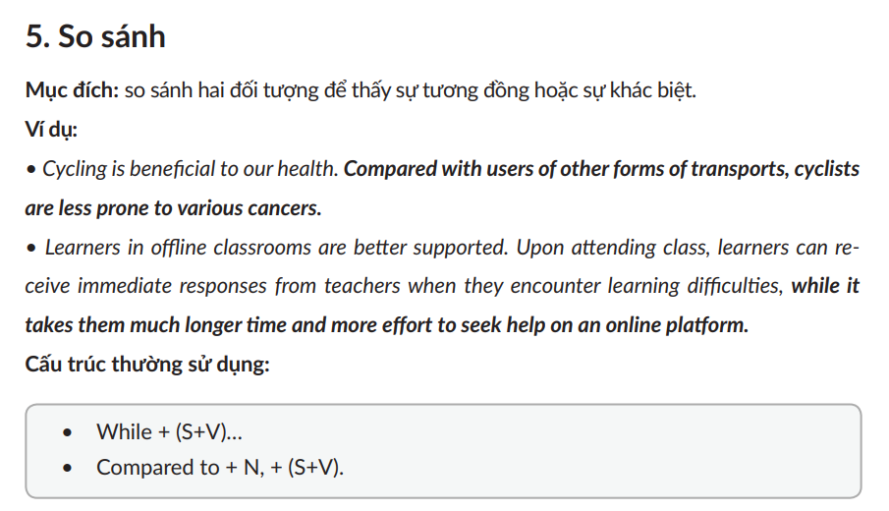



Slide 34
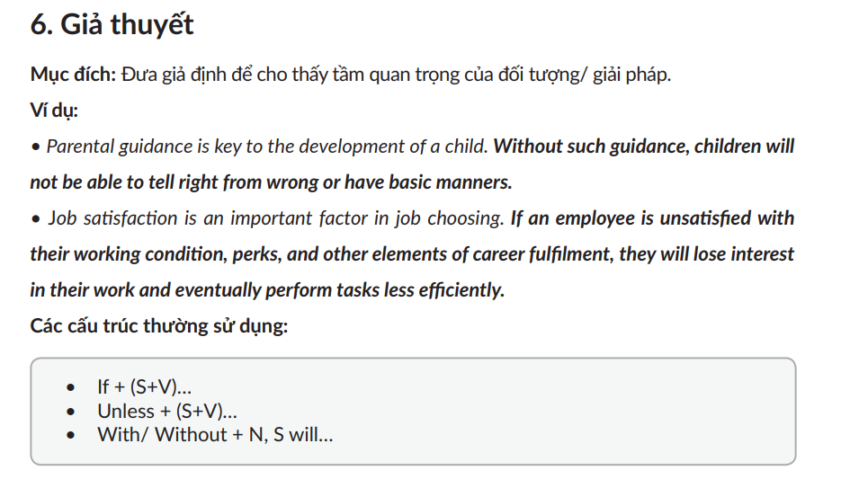


If he doesn’t go to school, he will fail a grade.
= Unless he goes to school, he will fail a grade

Slide 35
1. Do we need a separate sentence for each idea? - No, Idea 1 and its support can be in 1 sentence
Finally, there is a risk that rates of crime and antisocial behaviour may rise if the needs of a young population are not met.
2. How many ideas are perfect for a multiple-idea paragraph?
- 2 ideas - 5 – 6 sentences.

Slide 36
1. Think of the ideas. 2. Write a layout
Topic sentence (Câu mở đầu đoạn văn):
1.1 – Supporting sentences: reason or idea 1:
1.2 – Supporting sentences: support for 1:
1.3 – Supporting sentences: reason or idea 2:
1.4 – Supporting sentences: support for 2:
3. Write your paragraph.
4. Check your spelling, grammar.

Slide 37
It is generally believed that the Internet is an excellent means of communication but some people suggest that it may not be the best place to find information.

Slide 38
The Internet is an excellent means of communication in many reasons. The first reason is that it provides big amount of significant informations for people all over the world. As a result, we will improve our knowledge and the experience in our life better than before. Moreover, the internet is the best way for us to keep in touch with relatives, friends, etc by online messaging, video calling etc as if we cannot couldn't meet them for a long time and they are far from where we live. Finally, it is a type of entertainment media for today's youth after hard studying, working day. For instance, we can play games, listen to music, etc to heal our mind and relieve fatigue. In conclusion, Internet is important and it is a great means of communication for us to use on a daily basis = everyday widely in many countries.

Slide 39
The internet is a vast library with incredible amount of knowledge hidden inside it however it does have a lot of flaws with that large amount of information and some can be false. Firstly, a lot of the time informations about certain things are told in different kinds of perspective, this causes some informations to be misleading and can trick the reader to trust a certain kind of information that is either false or true. Secondly, the internet keeps sources and the original information anonymous that means most of the time people fake themselves to be the source of that information and can trick the viewer that their version of the kind of thing that they were looking for is the real thing. So quite frankly, the internet seemingly has endless amount of knowledge and information in its stock but a lot of the time they can be faulty and unreliable.

Slide 40
It is generally believed that the Internet is an excellent means of communication for many reasons. Firstly, there are many online tools to help you answer questions, typical examples are Google, Bing, etc where you just need to search and then there are thousands of information for you to find out. Secondly, there are many applications on the internet that help you connect with the community like Facebook, Twitter, ... Where you can share your feelings on it, it can also help you to get to know many people without going outside to meet them and have more other relationships. Finally, there are a lot of games online, so you can play them for fun after work or study, and you can message and get to know people through them.

Slide 41
Internet is very popular and useful for communication but ii is not the best place to find information. Firstly. informations on the Internet are not all correct. A lot of websites have uncensored and unsure information, so it will be bad if we update wrong news. Secondly, there are many risky webs. If you are unfortunate to visit toxic web, the virus or the hacker may access into your device. Finally, the Internet is not only the source of information, books, news,...are also wealthy source as well. In conclusion, Internet is an advantageous tool but there are also some disadvantages, too

Slide 42
I believe the internet can connect friendship with strangers or with foreigners. Because this is the era where technology is advancing, everyone is going to social media to be able to share their life and so they can find people who have a lot in common with them so that they can make friends. , get to know each other better. Or you can follow accounts that people you like, or admire, so you can see what they do every day. In short, the internet is also a means of communicating with people you know or may not know

Slide 43
The internet is an indispensable tool in human life. Firstly, the internet to find the information you need without having to go the library to search,. Second, it is an advanced international network that allows you meet friends from afar or work no matter where you are. Finally, the internet helps improve people's lives as currently students cannot go to school because of the epidemic, so online learning via the internet is very convenient for students to fight the epidemic and study well. Without a doubt, the in an indispensable thing in people's life.

Slide 44
Cooking helps develop Vietnamese tourism Main idea 1: Support: Main idea 2: Support:

